Slide 1

Topic :-
Self Controlling Vehicle Using PID Controller And Estimation Of Traffic Congestion

Slide 2
Guided By -
Jetendra Joshi Sir
Group Members -
Sujoy Roy
Anshuman Singh
Rajat Singh
Sachin Reddy
Rajat Sinha

Slide 3
Rational of the work
Objectives
Result OF The Work
Future Work
Difficulties
Preview

Slide 4
Rational of the work
VANET
PID Controller
Traffic Congestion Control
Usage of Big Data Hadoop
Traffic Prediction System

Slide 5
Objective
To study the implementation of PID controller and self driven automated cars.
To implement the interconnection of Network Model and Traffic Model and Estimation of Traffic Congestion.
To store the Floating Data on Big Data Hadoop.

Slide 6
METHODOLOGY
To Study the Traffic Simulation.
To Analyze the Simulation in NS-2 using SUMO.
To Study the Prediction of Bus Arrival Time.
To Store and Retrieve the Floating Data on Hadoop.

Slide 7
Recap

Slide 8
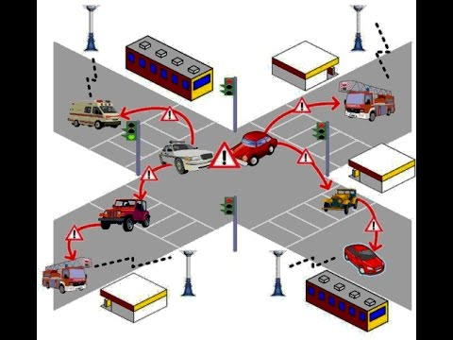
VANET
Image Courtesy - https://www.google.co.in/search?q=vanet&source=lnms&tbm=isch&sa=X&ved=0ahUKEwi865jX2uHRAhVEO48KHYNQB78Q_AUICCgB&biw=1304&bih=678#imgrc=yCTSf4K-VDvN3M%3A

Slide 9
What is PID ?
Proportional-integral-derivative (PID) control is the most common controller used in industry and has been universally accepted in industrial control.
The popularity of PID controllers can be attributed partly to their robust performance in a wide range of operating conditions.

Slide 10
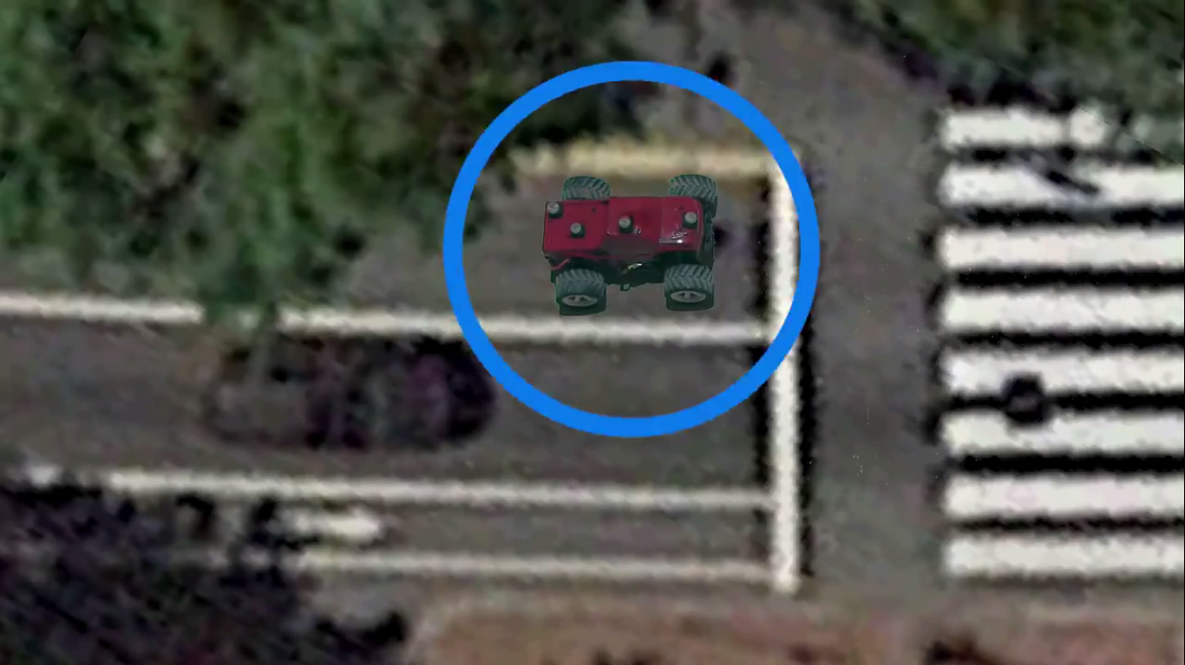
Localization of vehicle
Image courtesy:-https://www.youtube.com/watch?v=4Y7zG48uHRo&t=61s

Slide 11
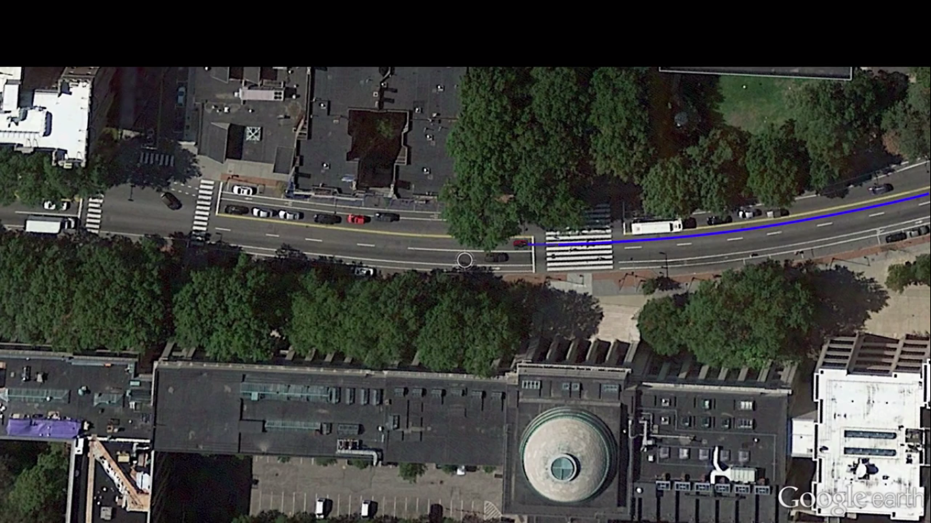
Defines its trajectory to destination
Image courtesy:-https://www.youtube.com/watch?v=4Y7zG48uHRo&t=61s

Slide 12
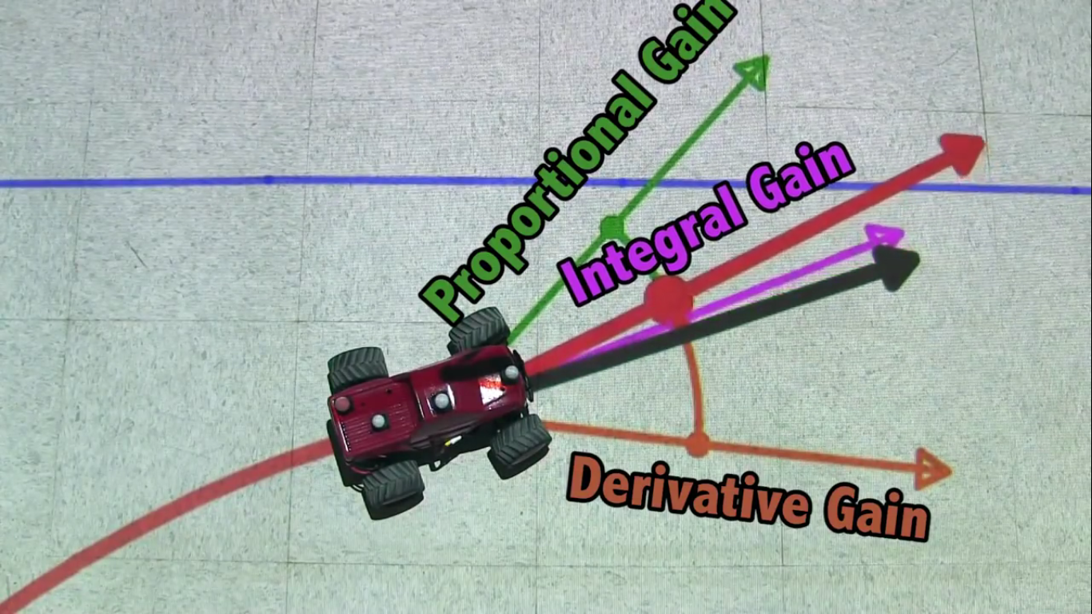
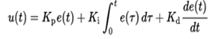
Image courtesy:-https://www.youtube.com/watch?v=4Y7zG48uHRo&t=61s

Slide 13
TRAFFIC CONGESTION AND DETECTION USING BIG DATA
Reduces Travel Time.
V2V and V2I communication obtained using OBU.
RSU.

Slide 14
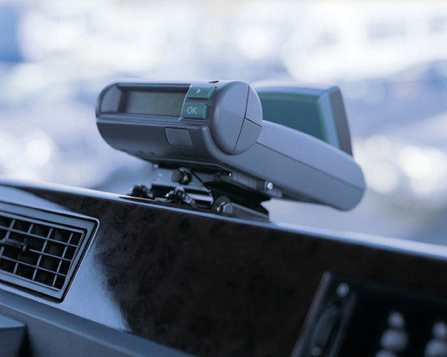
OBU
On Board Units.
Positioning of the Vehicle.
Speed at one-second interval.
Sends data to the cluster heads.
Reference :- https://www.google.co.in/search?q=on+board+unit&source=lnms&tbm=isch&sa=X&sqi=2&ved=0ahUKEwjT6MrHqsDTAhXLNY8KHYgYB-EQ_AUIBigB&biw=1304&bih=629#imgrc=VevVq3Jo6CobAM:

Slide 15
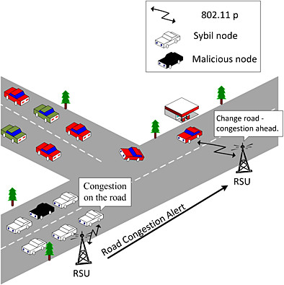
RSU/GATEWAY
Road Side Units.
Forwards information cluster for storage.
Process and defines the traffic congestion.
At specific locations.
Reference :-https://www.google.co.in/search?q=on+board+unit&source=lnms&tbm=isch&sa=X&sqi=2&ved=0ahUKEwjT6MrHqsDTAhXLNY8KHYgYB-EQ_AUIBigB&biw=1304&bih=629#tbm=isch&q=road+side+unit&imgdii=tagTLP71z1-WLM:&imgrc=wBfJzA987aXqAM:

Slide 16
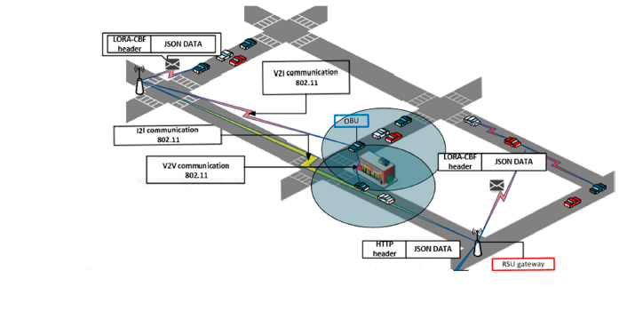
Reference :- Néstor Cárdenas-Benítez 1, Raúl Aquino-Santos 1, Pedro Magaña-Espinoza 2,*, José Aguilar-Velazco 1, Arthur Edwards-Block 1 and Aldo Medina Cass 3

Slide 17
Data collection
The route chosen for this study was Delhi transport corporation (DTC) bus route 78 in new Delhi, India.
This is one of the important routes in the city, with a length of approximately 18 km and a travel time of 60–70 minutes. The route comprises 13 bus stops connecting Azadpur bus terminal to Naraina depot via Wazirpur, Punjabi Bagh, and Naraina, all of which are important and relatively crowded bus stops.

Slide 18
Link Running time Prediction Prediction
ATn (i+1) = DTn (i) +RT n (i,i+1) Where,
ATn (i+1) is the predicted arrival time of bus n at stop i+1
RTn (i,i+1) is the predicted running time between i and i+1
DTn (i) is the actual departure time of bus n from stop i

Slide 19
Stop Name | Distance between Stops (km) | Cumulative Distance (km)
Azadpur Terminal | 0.00 | 0.00
Shalimar Bagh | 1.30 | 1.30
Ashok Vihar | 0.40 | 1.70
Perambari Pul | 0.75 | 2.45
Wazirpur Depot | 0.70 | 3.15
Britania Factory | 1.70 | 4.85
Punjabi Bagh | 3.80 | 8.65
Rampura | 2.20 | 10.85
Zakhira | 1.20 | 12.05
Swatantra Mills | 0.24 | 12.29
Moti Nagar | 2.60 | 14.89
Sp. Depot | 1.80 | 16.69
Naraina Depot | 0.85 | 17.54
Reference:- https://nctr.usf.edu/jpt/pdf/JPT%207-1%20Shalaby.pdf

Slide 20
segments | DTn (i) | RTn (i,i+1) | ATn (i+1)
Azadpur - Shalimar Bag | 8:15AM | 6 MIN | 8:21 AM
Shalimar Bag-Ashok Vihar | 8:22AM | 3 MIN | 8:25 AM
Ashok Vihar- Perambari Pul | 8:26 AM | 4 MIN | 8:30 AM
PerambariPul- Wazirpur Depot | 8:31 AM | 4 MIN | 8:35 AM
Wazirpur Depot- Britania Factory | 8:36 AM | 7 MIN | 8:43 AM
Britania Factory-Punjabi Bag | 8:44 AM | 10 MIN | 8:54 AM
Punjabi Bagh-Rampura | 8:55 AM | 8 MIN | 9:03 AM
Rampura - Zakhira | 9:04 AM | 6 MIN | 9:010 AM
Zakhira - Swatantra Mills | 9:11 AM | 2 MIN | 9:13 AM
Swatantra Mills-Moti Nagar | 9:14 AM | 7 MIN | 9:21 AM
Moti Nagar-Sp. Depot | 9:22 AM | 3 MIN | 9:25 AM
Sp. Depot - Naraina Depot | 9:25 AM | 2 MIN | 9:27 AM

Slide 21
RESULT of work

Slide 22
hadoop

Slide 23
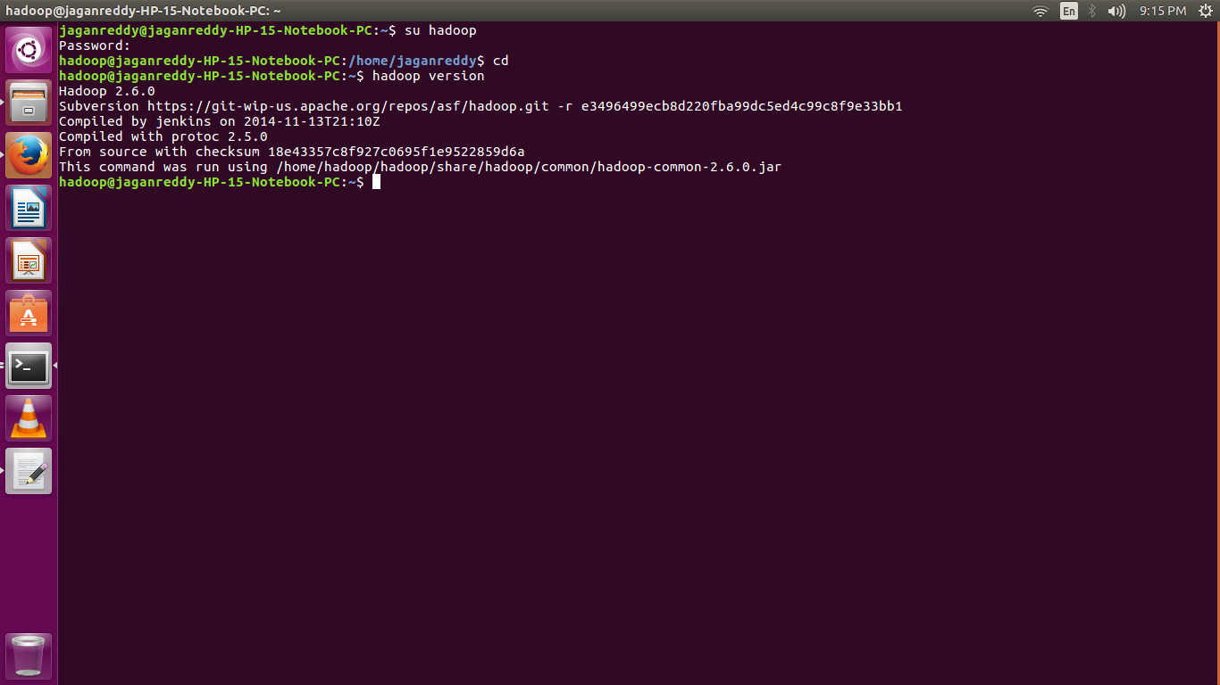
Hadoop Version

Slide 24
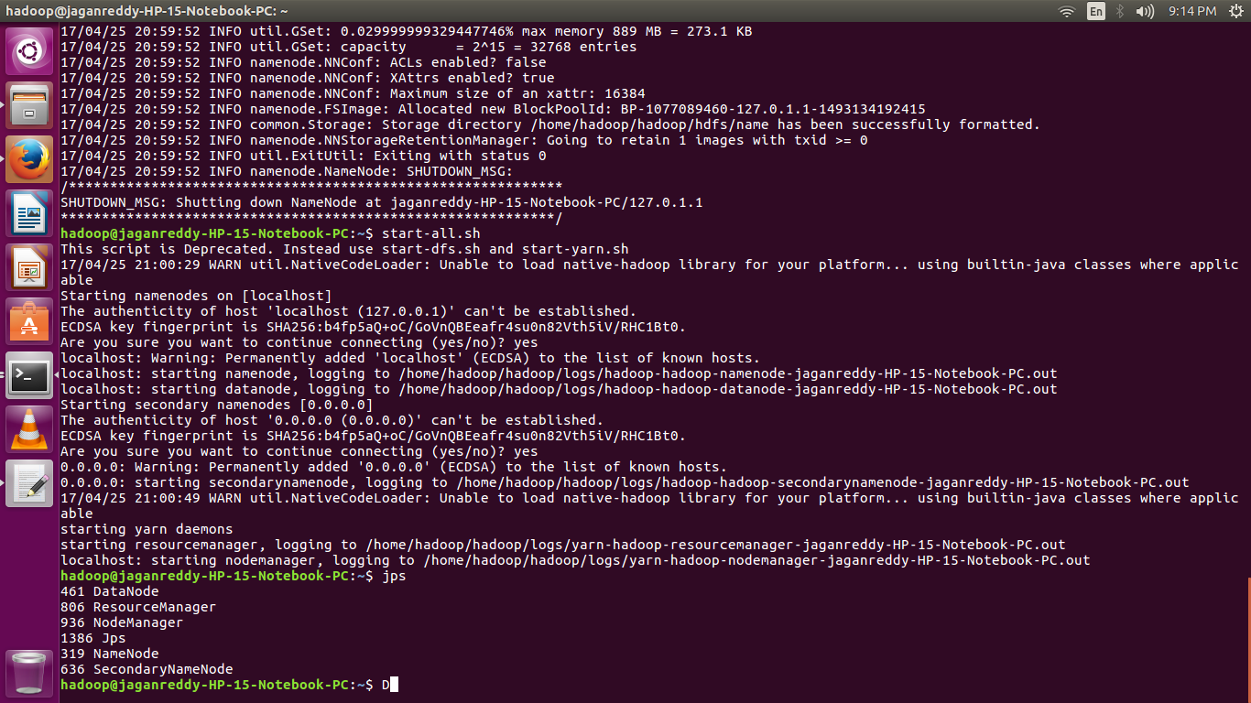
Hadoop Started

Slide 25
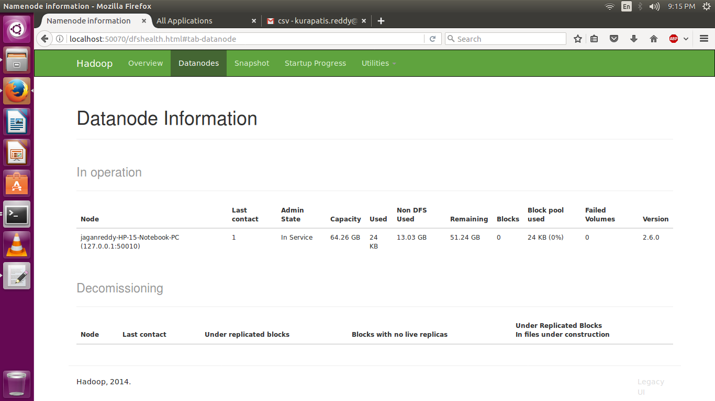
Datanode information

Slide 26
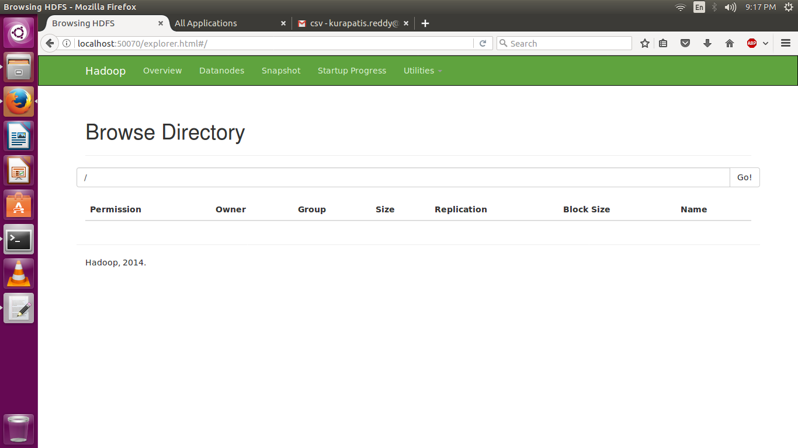
Storage Browser

Slide 27
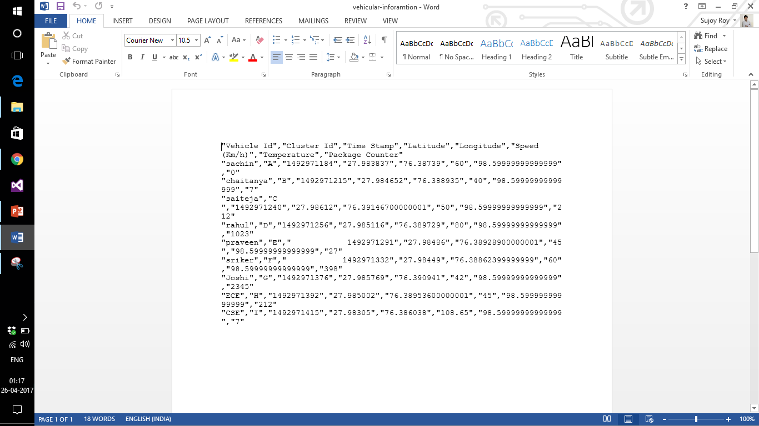
Vehicular information

Slide 28
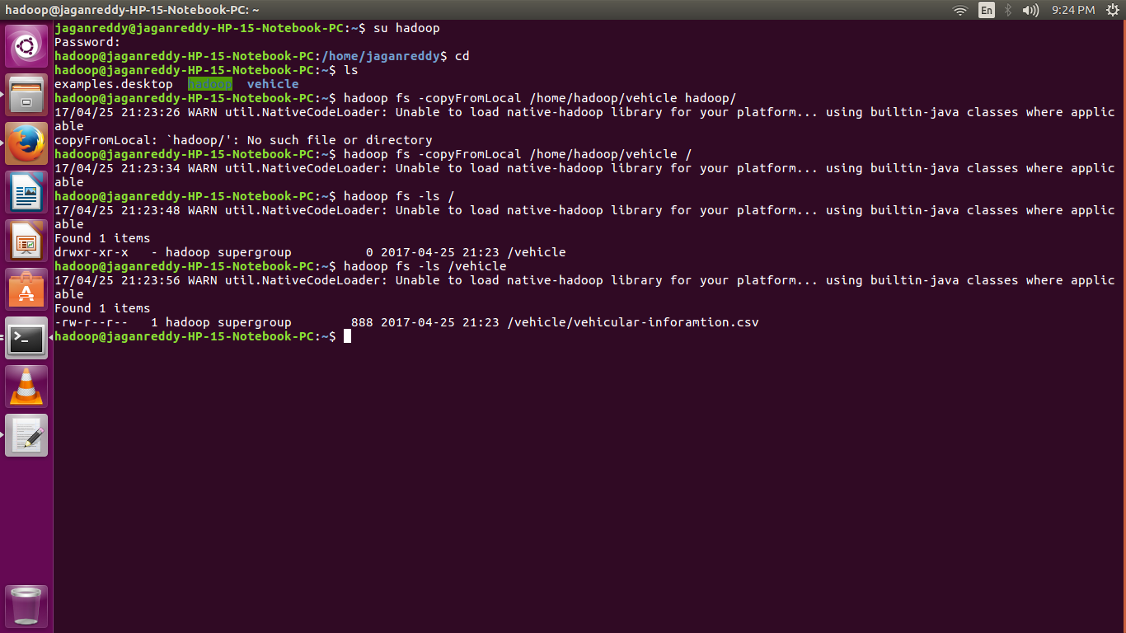
Hadoop from local

Slide 29

Storage browser

Slide 30
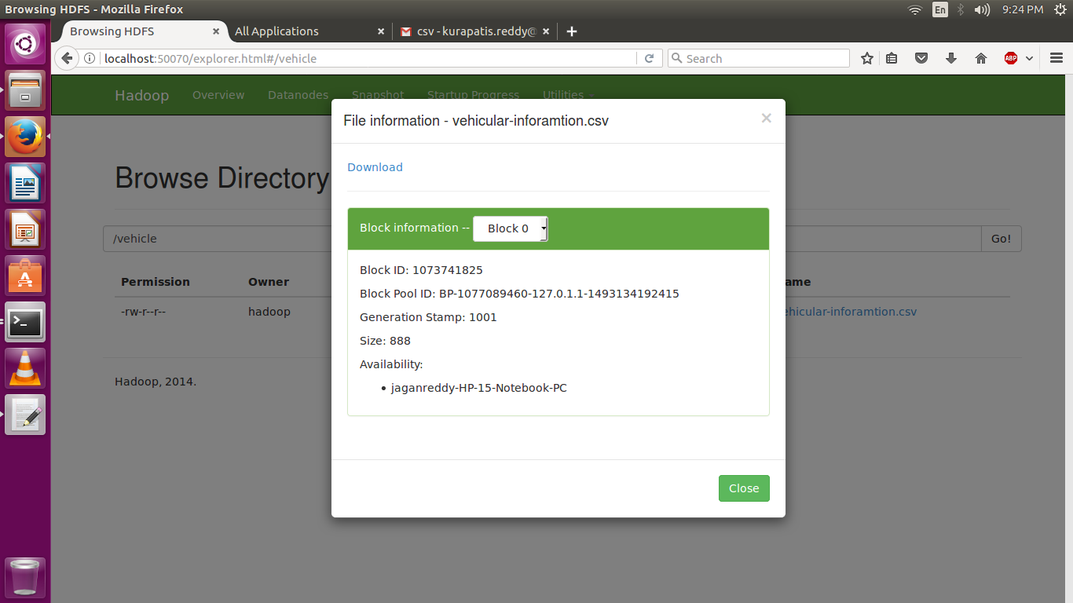
File information

Slide 31
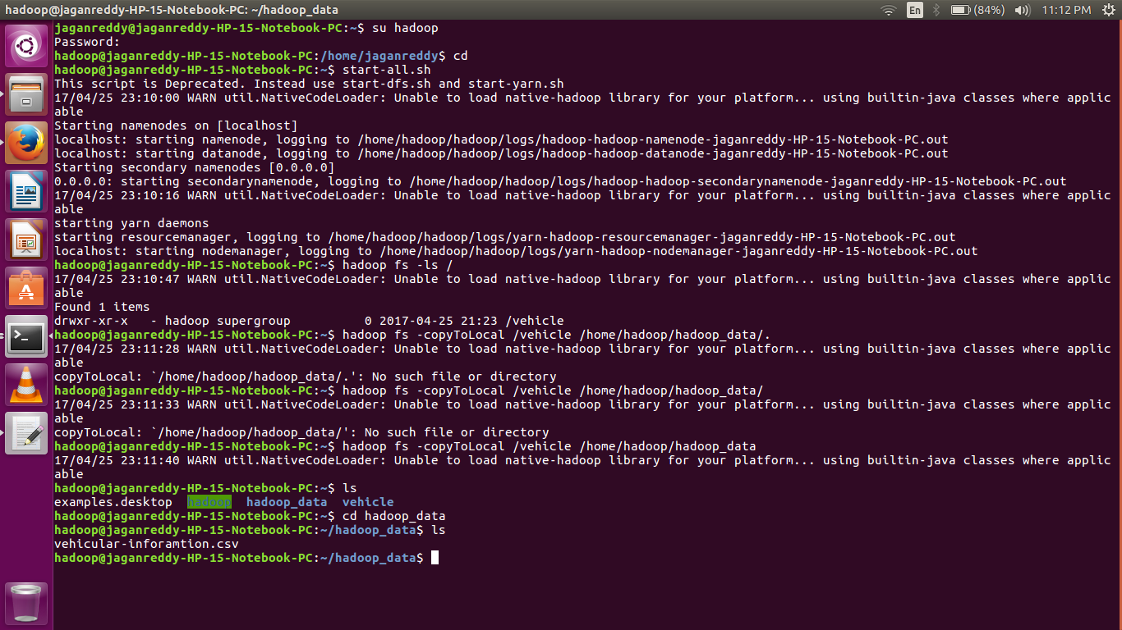
Hadoop to local

Slide 32
SIMULATION
Simulation of real-time traffic using dummy data in SUMO and NS2.
Obtaining the floating data of each vehicle : longitude, latitude and speed.
Predicting traffic congestion with the help of a trace file obtained in between the process.
Disseminating the relevant information (using V2V and V2I) to other vehicles.

Slide 33
VIDEO

Slide 34
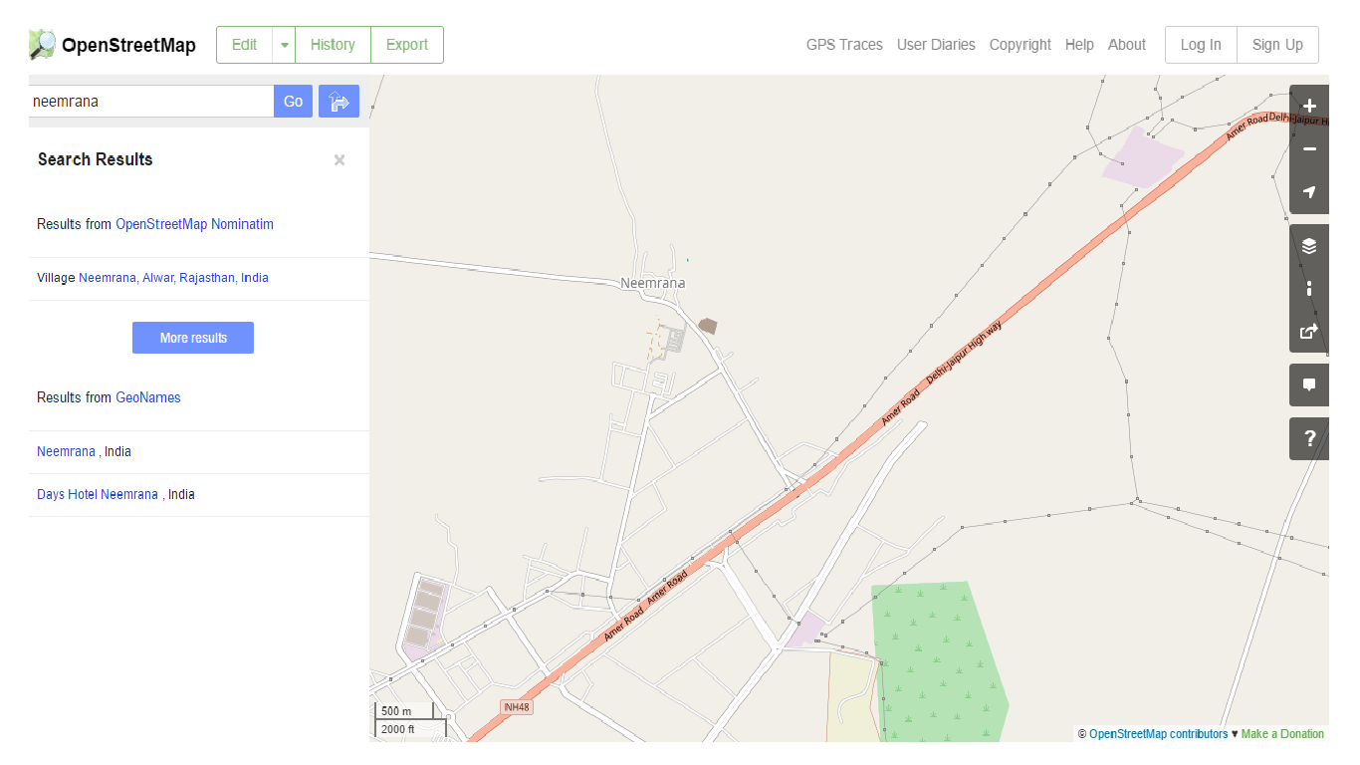
OpenStreet Map

Slide 35
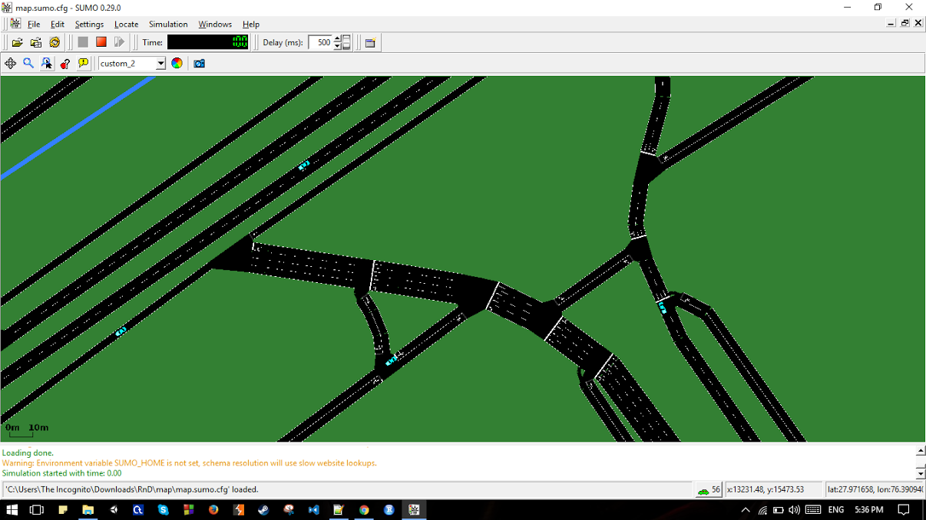
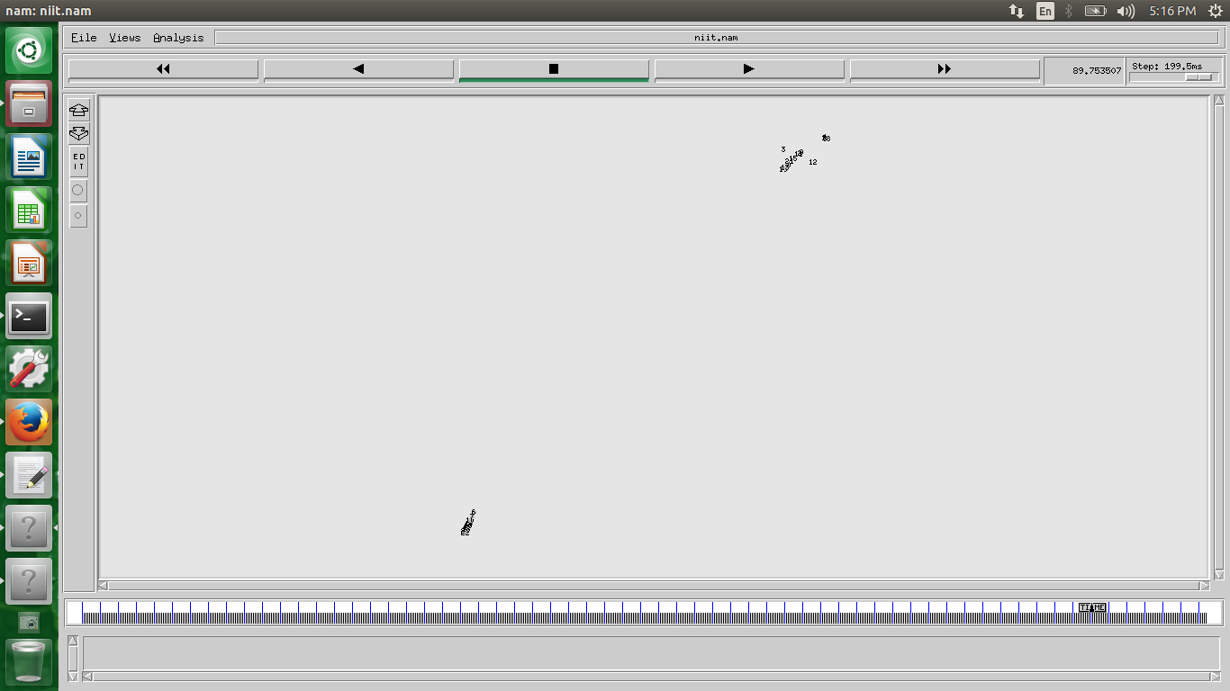

Slide 36
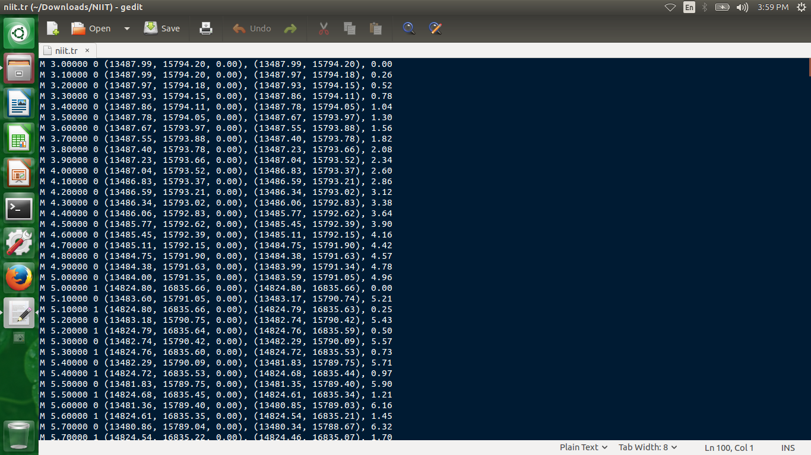
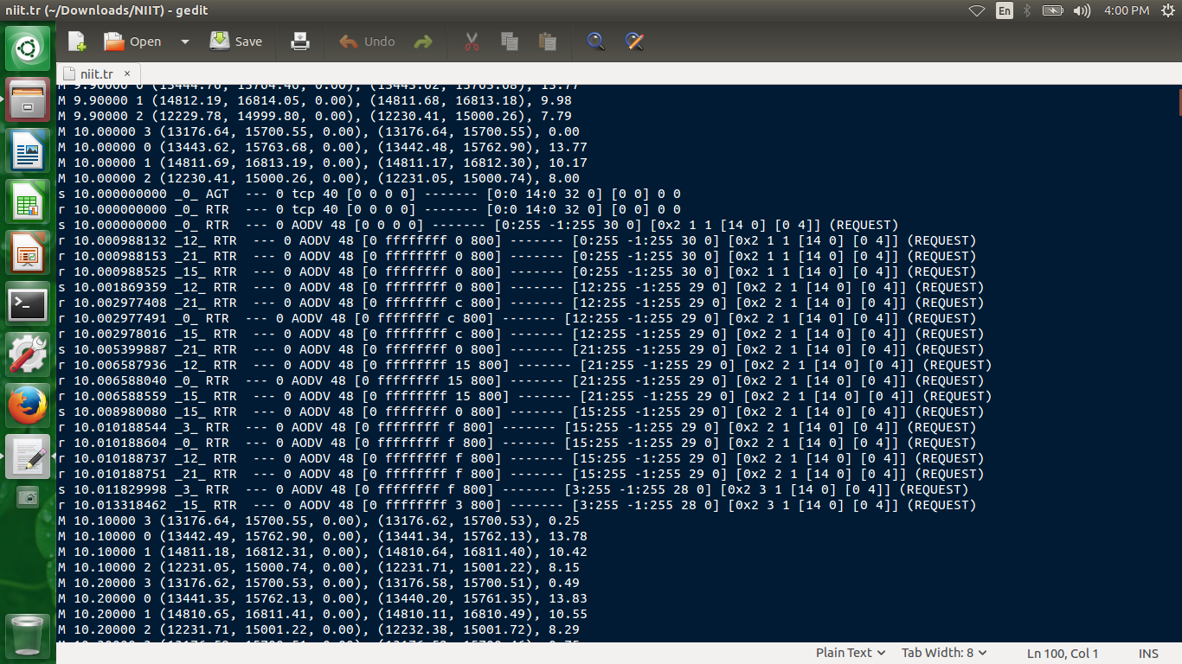
Trace File

Slide 37
Pseudo code for traffic congestion
X ----- Will be a variable, for the incoming vehicle id.
While (true) -------------------- the loop will run continuously
{
If ((xlang < lang1 && xlang > lang2) && (xlong < long1 && xlong > long2))
Count ++;
}
If (count > threshold_value)
{
// updated message will be broadcast about traffic congestion
}

Slide 38
conclusion

Slide 39
Future work
To compare the performance measure of various prediction models and choose the efficient.
A large number of OBU’s should be implanted on different vehicles.
Forming Multiple Cluster in Hadoop.
Using the NS3 version for simulation.

Slide 40
Difficulties
High Performance Machines should be available at hardware level for proper functioning of real-time system.
Faced Difficulty in choosing the Prediction Model.
Running Simulation Using NS2 and NAM in Ubuntu.

Slide 41
Thank YOU

